Slide 1
Riyadh Restuarants Dataset
T5 Bootcamp Data Science Project
Fai Abdulrahman Albadri

Slide 2
01
Project Goal

Slide 3
Project Goal
The goal of our project is to see different reastuarants from different categories and prices and discover the most retuarants customer prefare.
And show the relationships between the features in each restuarant.

Slide 4
02
Data Set

Slide 5
DataSet
It contains 19360 Restaurant , each Restaurant has 11 features

Slide 6
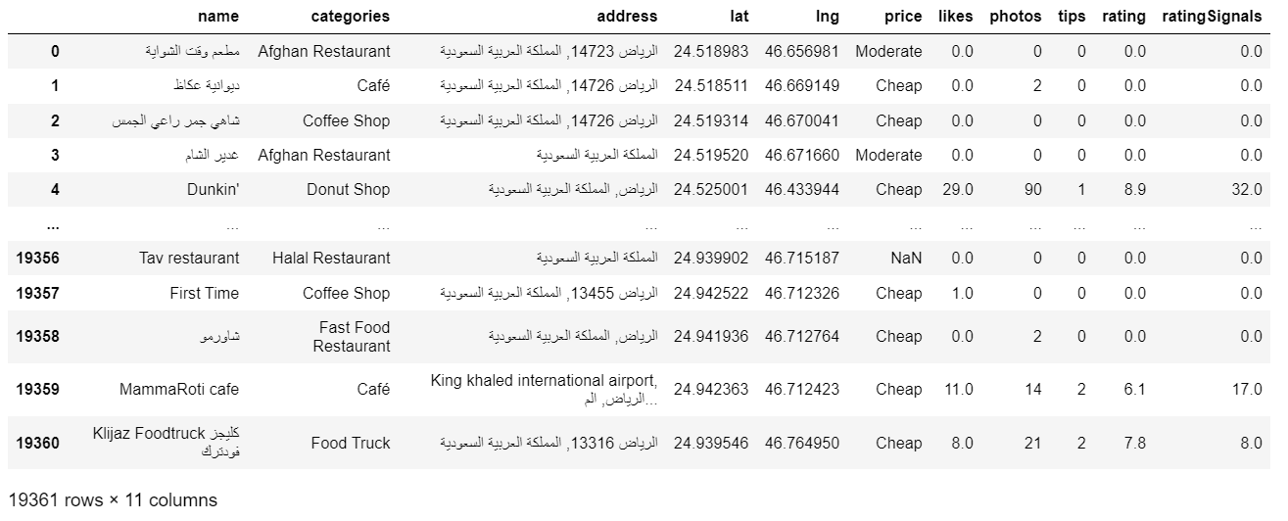
DataSet

Slide 7
03
Data Analysis and Models

Slide 8
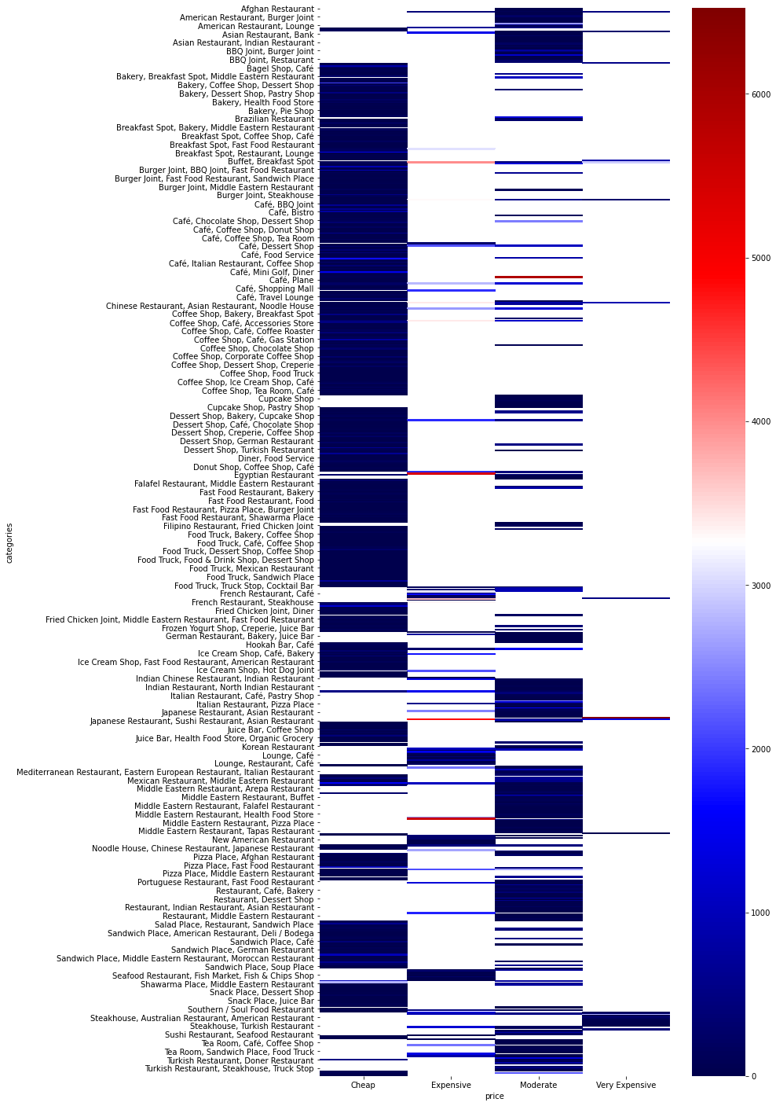
Visualizing with Seaborn Heatmap

Slide 9
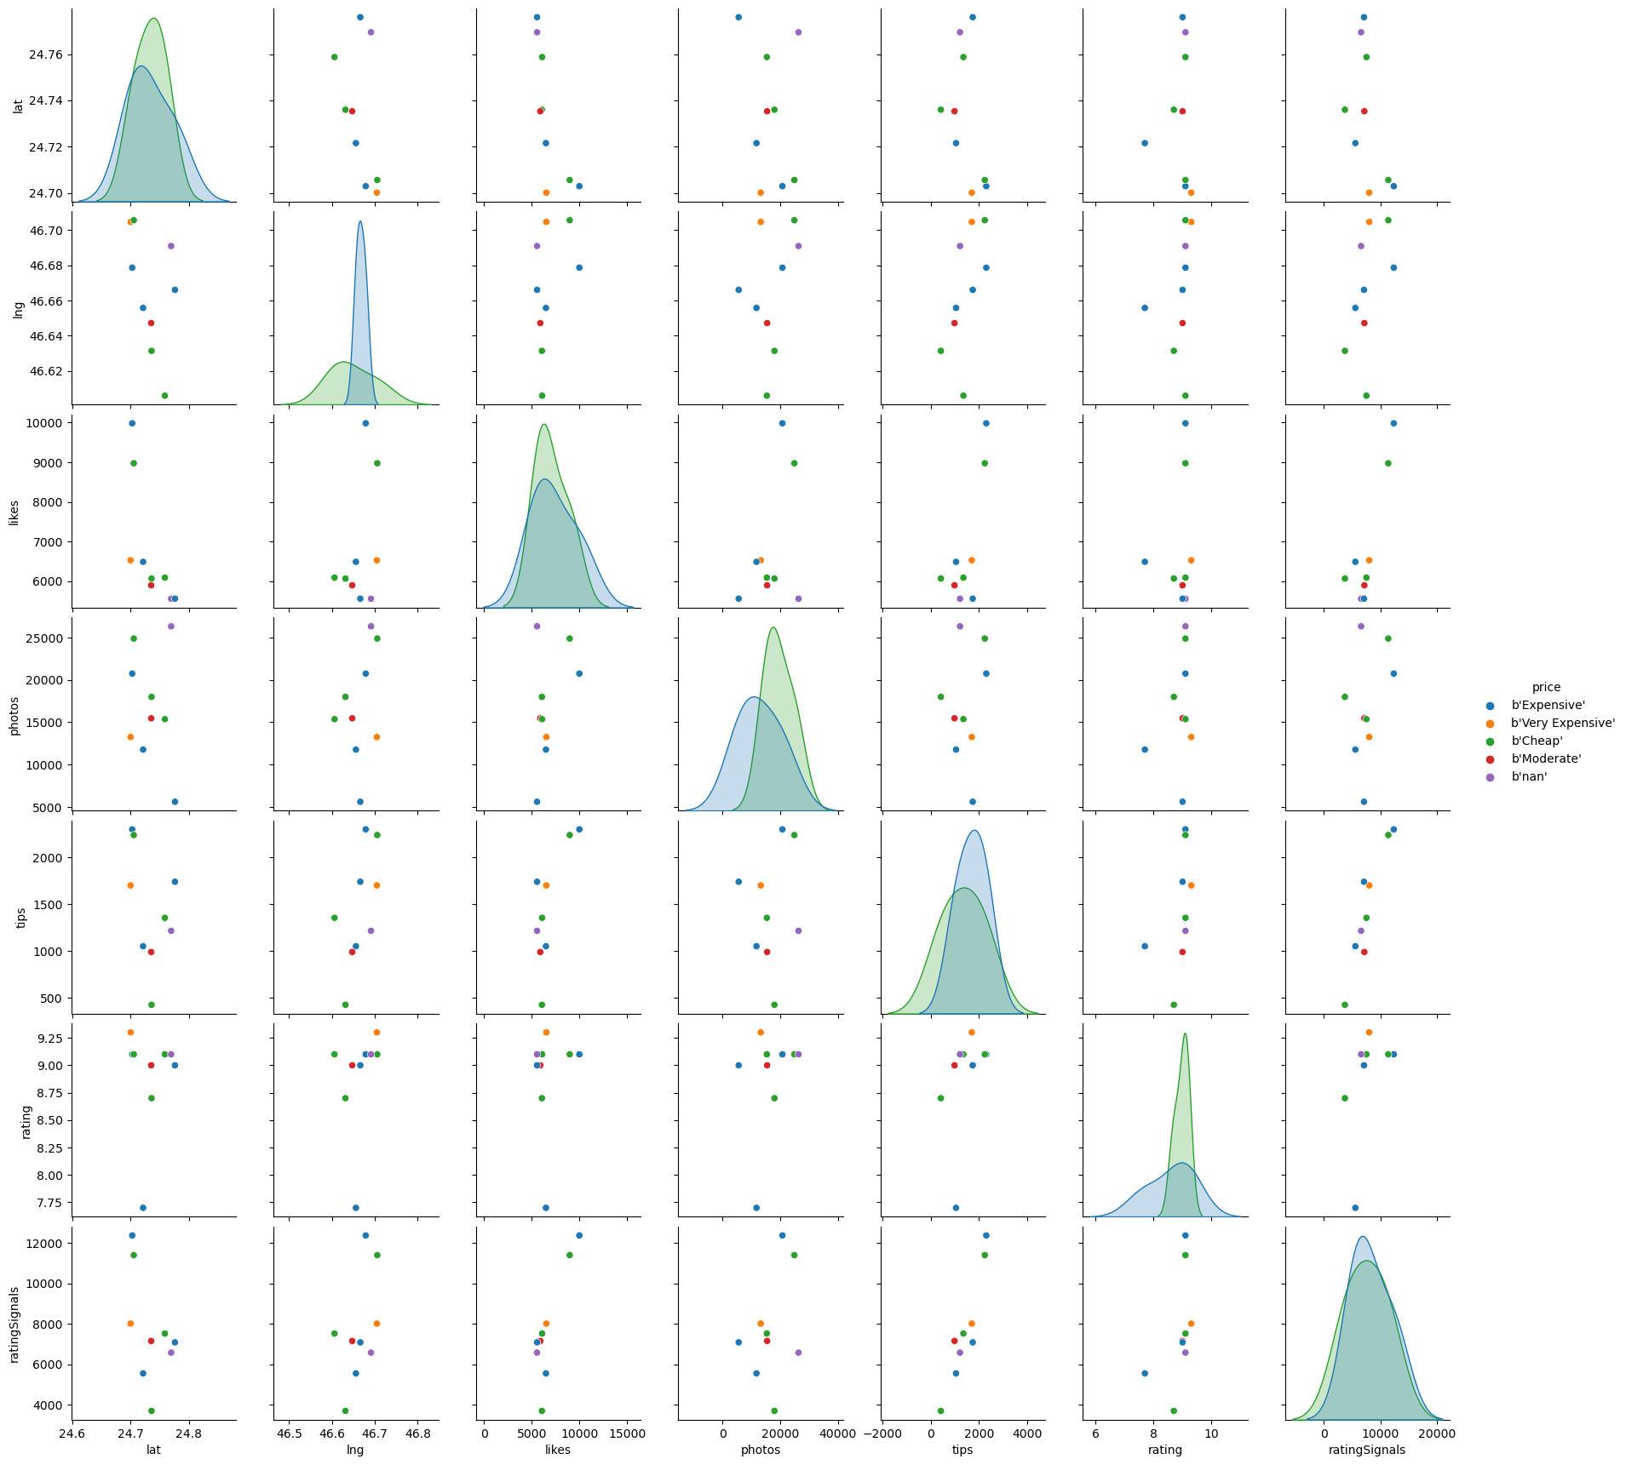
EDA

Slide 10
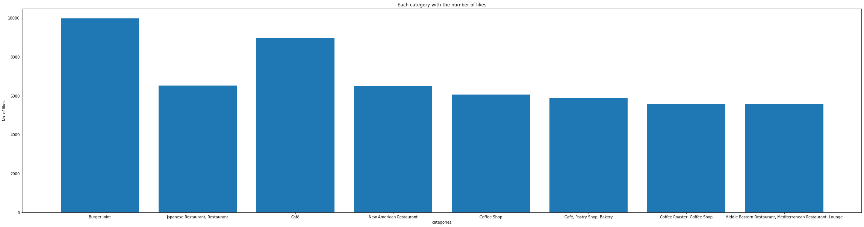
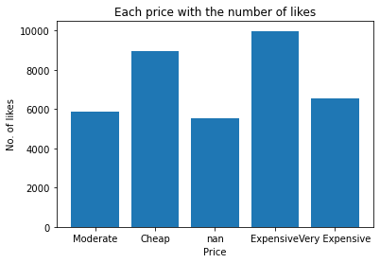
Relationship Between Features

Slide 11
Relationship Between Features

Slide 12
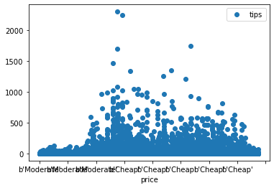
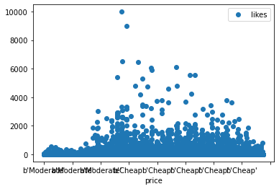
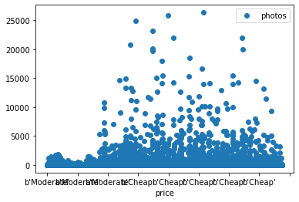
Linear Regression

Slide 13
Upcoming Goals
January
February
March
April
Goal 1
Phase 1
Phase 2

Slide 14
…And the Same Goes for Tables
 | Mass (earths) | Diameter (earths) | Gravity (earths)
Mercury | 0.06 | 0.38 | 0.38
Mars | 0.11 | 0.53 | 0.38
Saturn | 95.2 | 9.4 | 1.16

Slide 15
Thank You for Your Attention

